Slide 1

GREEDY METHOD
UNIT 2

Slide 2
THE GENERAL METHOD
Most straightforward design technique
Feasible solution: Any subset that satisfies the constraint
Optimal solution: A feasible solution that maximizes or minimizes a given objective function.
Subset paradigm: Locally optimal leads to globally optimal solution.
Ordering paradigm: Make decisions by considering the inputs in some order using optimization criterion

Slide 3
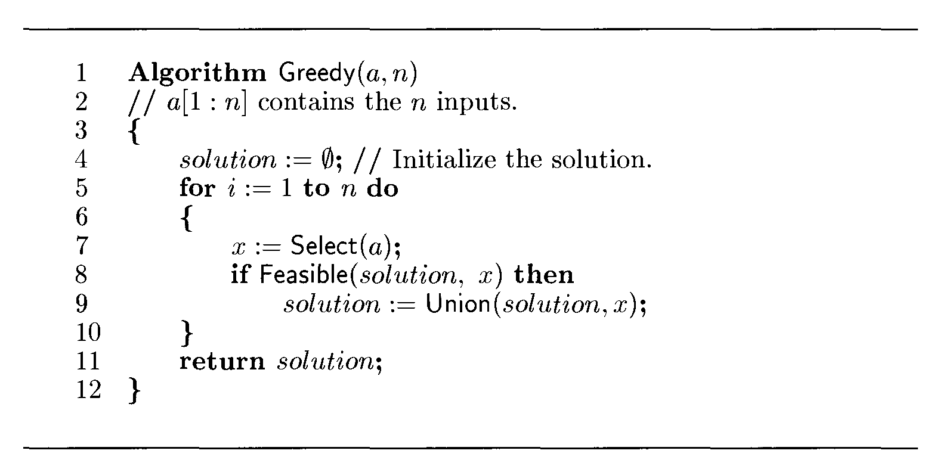
Greedy method control abstraction for subset paradigm

Slide 4
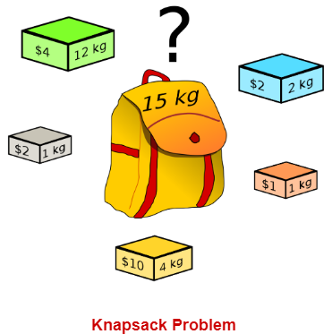
The Knapsack Problem
The classic Knapsack problem is:
  A thief breaks into a store and wants to fill his knapsack of capacity K with goods of as much value as possible.
  Does there exist a collection of items that fits into his knapsack and whose total value is >= W?

Slide 5
Knapsack Problem
Fractional Knapsack
0/1 Knapsack

Slide 6
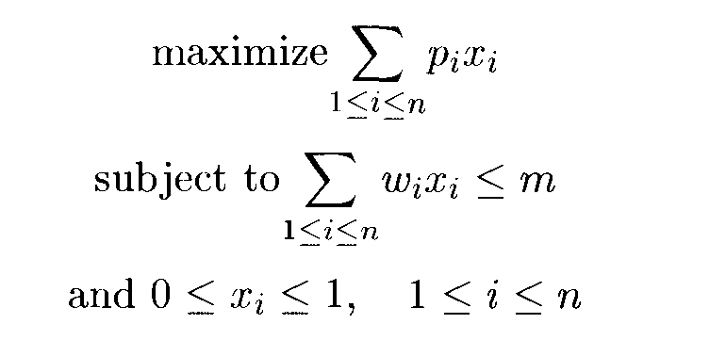
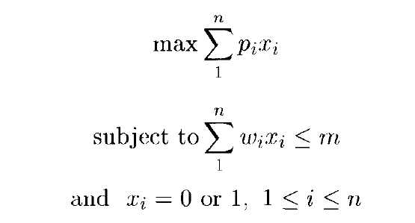
KNAPSACK PROBLEM
Fractional Knapsack
0/1 Knapsack

Slide 7
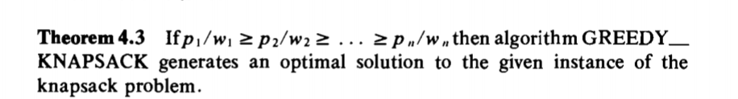

Slide 8
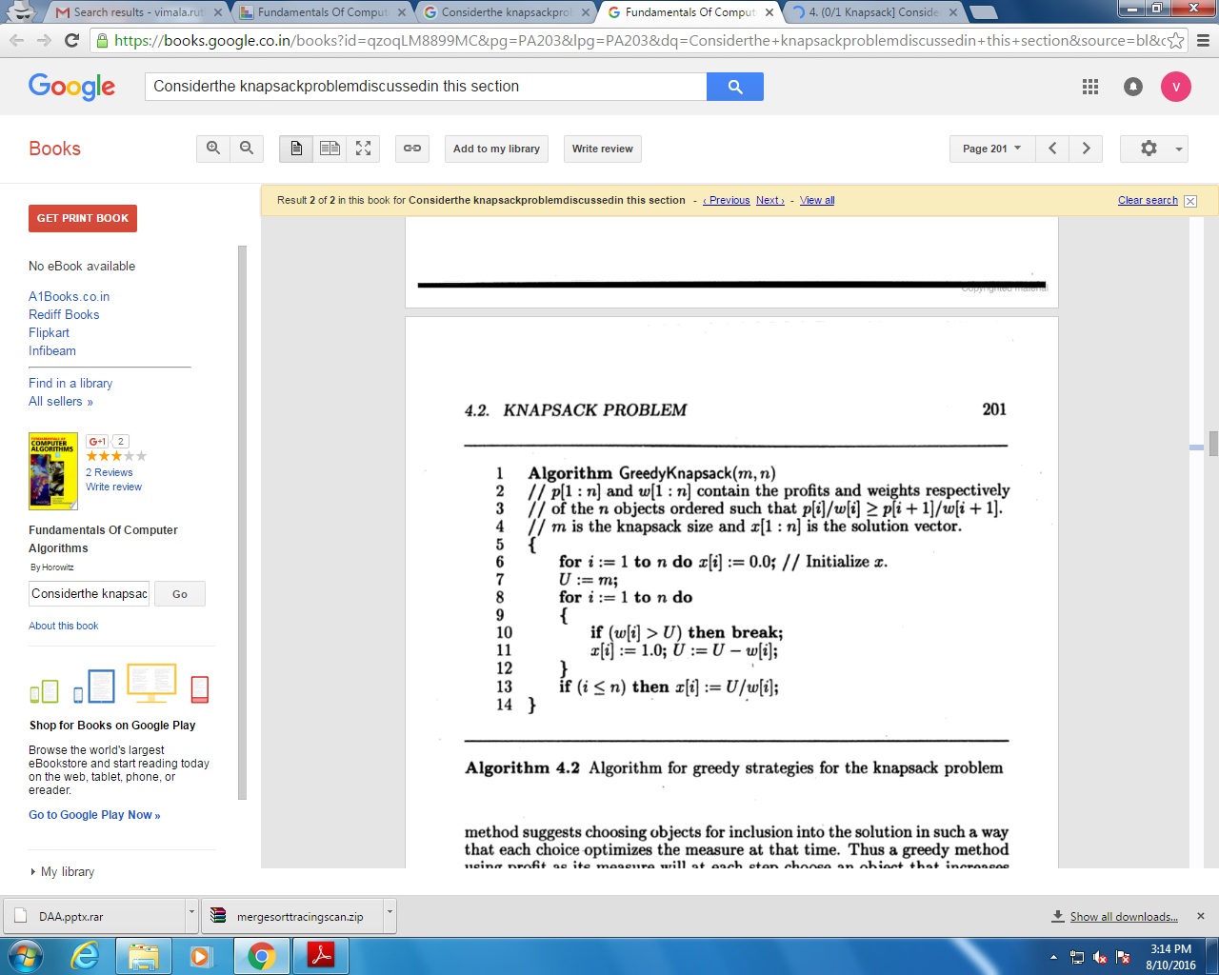
Time Complexity is O(nlogn)
Notes:
Analysis
Fractional Knapsack has time complexity O(NlogN) where N is the number of items in S.
The book suggests assuming S is a heap-based priority queue and then the removal has complexity Θ(logN) so the up to N removals take O(NlogN). The rest of the algorithm is O(N).
Alternatively, S could be a sequence and we could begin Fractional Knapsack by sorting S with a Θ(NlogN) sort. Now the removal is simply removing the first element. If we use a circular list for S, the removal is O(1) so the algorithm is O(N). Including the sort we again have O(NlogN).

Slide 9
Applications
Finding the least wasteful way to cut raw materials.
Selection of investments and portfolios.
Selection of assets for asset-backed securitization
Generating keys for the Merkle–Hellman and other knapsack cryptosystems.
One early application of knapsack algorithms was in the construction and scoring of tests in which the test-takers have a choice as to which questions they answer and score the maximum.

Slide 10
Examples
Find the optimal solution for the fractional knapsack problem making use of greedy approach.
Problem 1:
n = 5
m = 60 kg
(w1, w2, w3, w4, w5) = (5, 10, 15, 22, 25)
(b1, b2, b3, b4, b5) = (30, 40, 45, 77, 90)
Problem 2:
n=7
m=15
(p1, p2, …, p7) = (10, 5, 15, 7, 6, 18, 3)
(w1, w2, …, w7) = (2, 3, 5, 7, 1, 4, 1)

Slide 11
Does Greedy Method give optimal solution for 0-1 Knapsack?
M=60
Items : Pi={100,280,120},Wi={10,40,20}
Greedy approach may not give an optimal solution.
To solve 0-1 Knapsack, Dynamic Programming approach is required.

